Slide 1
Mini Popper | Colt poppers | Pepper poppers | Plates | Wall feet
8 | 6 | 1 | 0 | 50
Bay | Stage | Target Type | Count | NS | Total | Hard Cover
A1 | Go Down Range | IPSC | 9 | 2 | 11 | 1 Left Diag 2 Right Diag
A2 | Don't Tell Me What To Do | USPSA | 8 | 1 | 9 | 2 Tux 1 Right Diag
B1 | CM 13-07 Double Deal 2 | USPSA | 2 | 2 | 4 | 1 50%
B2 | Table Angles | USPSA | 10 | 2 | 12 | 1 Tux
B3 | Done Done Done | ISPC | 11 | 1 | 12 | 1 Tux

Slide 2
Prop | Stage
Swinger | A1

Slide 3


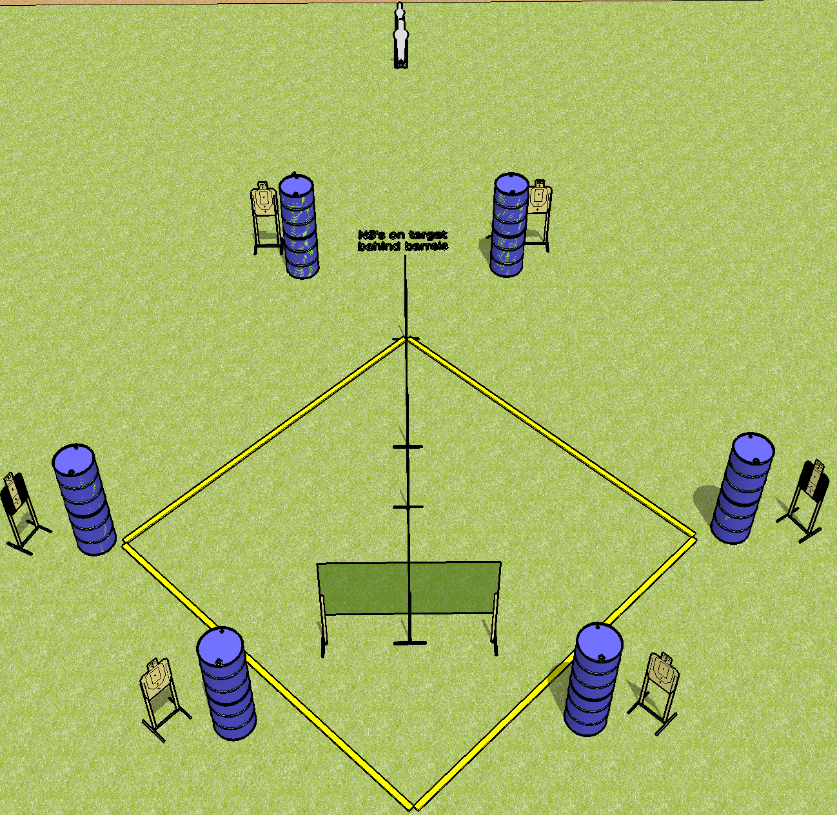
 | Dothan Gun Club – USPSA Match Diamond in the Rough Course Designer : BPPS Bay: B4
Round Count 18 rounds 8 USPSA 1 pepper, 1 mini
Equipment List 6 wall feet 2 tux

Slide 4
Diamond in the Rough
Written Stage Briefing
Scoring: Comstock Rounds: 18 rounds
Targets: 8 USPSA, 2 steel
Handgun start position: hands on marks. Handgun is loaded and holstered.
PCC start position: muzzle touching either mark, stock on belt. Loaded carbine is held with both hands, safety on.
Stage Procedure: on the audible start signal, engage targets as they become available from within the shooting area.

Slide 5
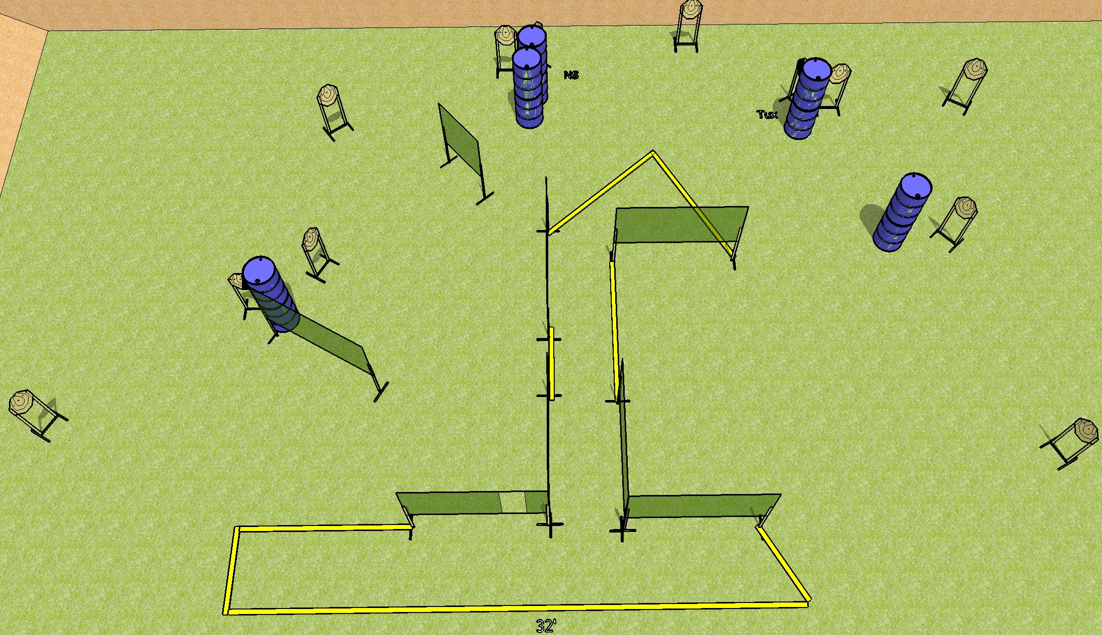
 | Dothan Gun Club – USPSA Match Done Done Done Course Designer : Drew Coleman Bay: B3
Round Count 24 rounds 12 IPSC
Equipment List 14 wall feet 1 tux 12 targets (11 + 1NS)

Slide 6
Done Done Done
Written Stage Briefing
Scoring: Comstock Rounds: 24
Targets: 12 IPSC
Handgun start position: feet on X’s, wrists below belt. Handgun is loaded and holstered.
PCC start position: feet on X’s, stock on belt. Loaded carbine is held with both hands, safety on.
Stage Procedure: on the audible start signal, engage targets as they become available from within the shooting area.

Slide 7
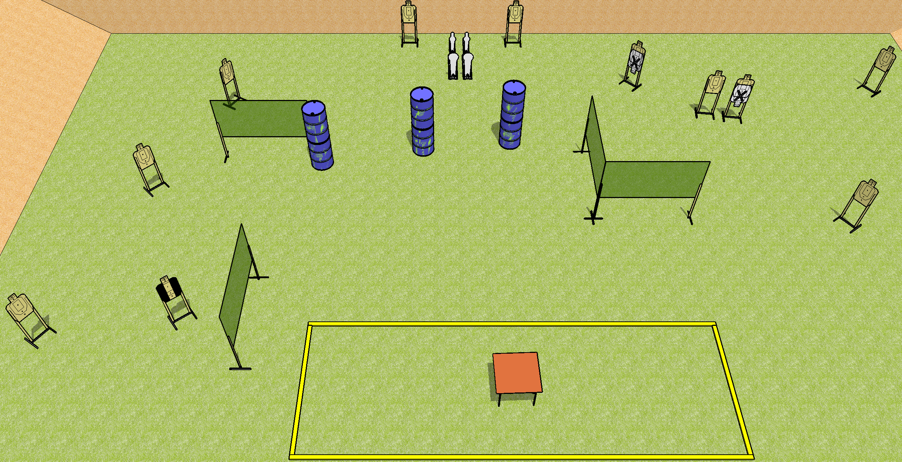
 | Dothan Gun Club – USPSA Match Table Angles Course Designer : Drew Coleman Bay: B2
Round Count 26 rounds 11 USPSA 2 colt poppers, 2 minis
Equipment List 7 wall feet Table 1 tux 12 targets (10 + 2 NS)

Slide 8
Table Angles
Written Stage Briefing
Scoring: Comstock Rounds: 26
Targets: 11 USPSA, 4 steel
Start position: anywhere inside the shooting area, wrists above shoulders. Firearm and first magazine is on table, unloaded, unpropped.
Stage Procedure: On the audible start signal, engage targets as they become available from within the shooting area.

Slide 9
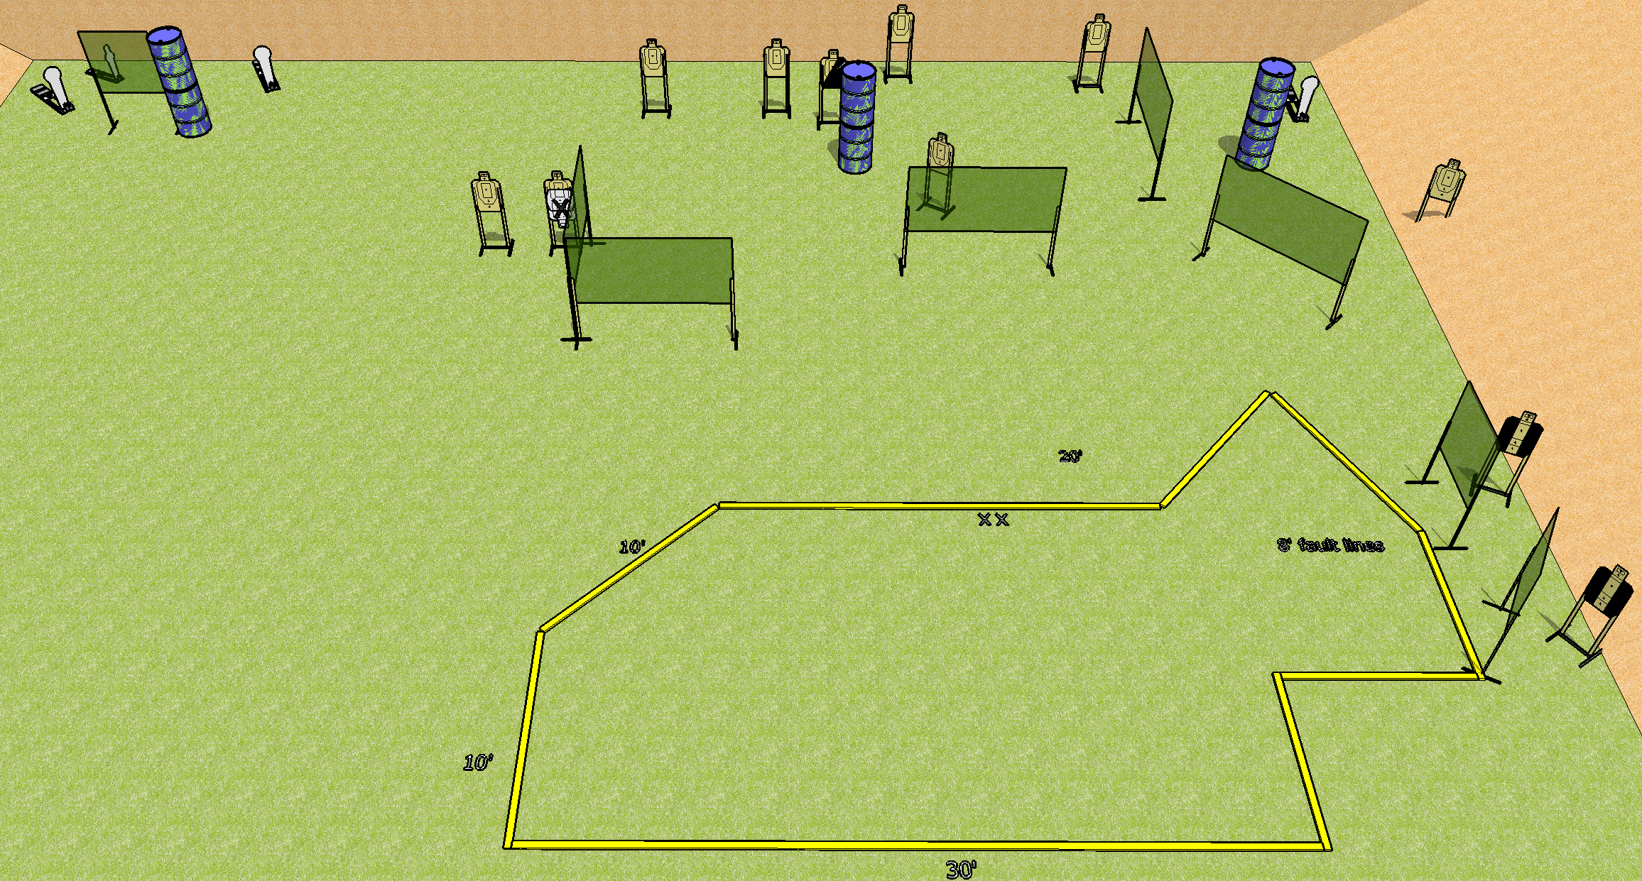
 | Dothan Gun Club – USPSA Match Don’t Tell Me What To Do Course Designer : Drew Coleman Bay: A2
Round Count 26 rounds 11 USPSA 3 colt poppers, 1 mini
Equipment List 15 wall feet 3 4’ walls 2 tux, 1 right diag 9 targets (8 + 1NS)

Slide 10
Don’t Tell Me What To Do
Written Stage Briefing
Scoring: Comstock Rounds: 26
Targets: 11 USPSA, 4 steel
Handgun start position: feet on X’s, wrists below belt. Handgun is loaded and holstered.
PCC start position: feet on X’s, stock on belt. Loaded carbine is held with both hands, safety on.
Stage Procedure: on the audible start signal, engage targets as they become available from within the shooting area.

Slide 11
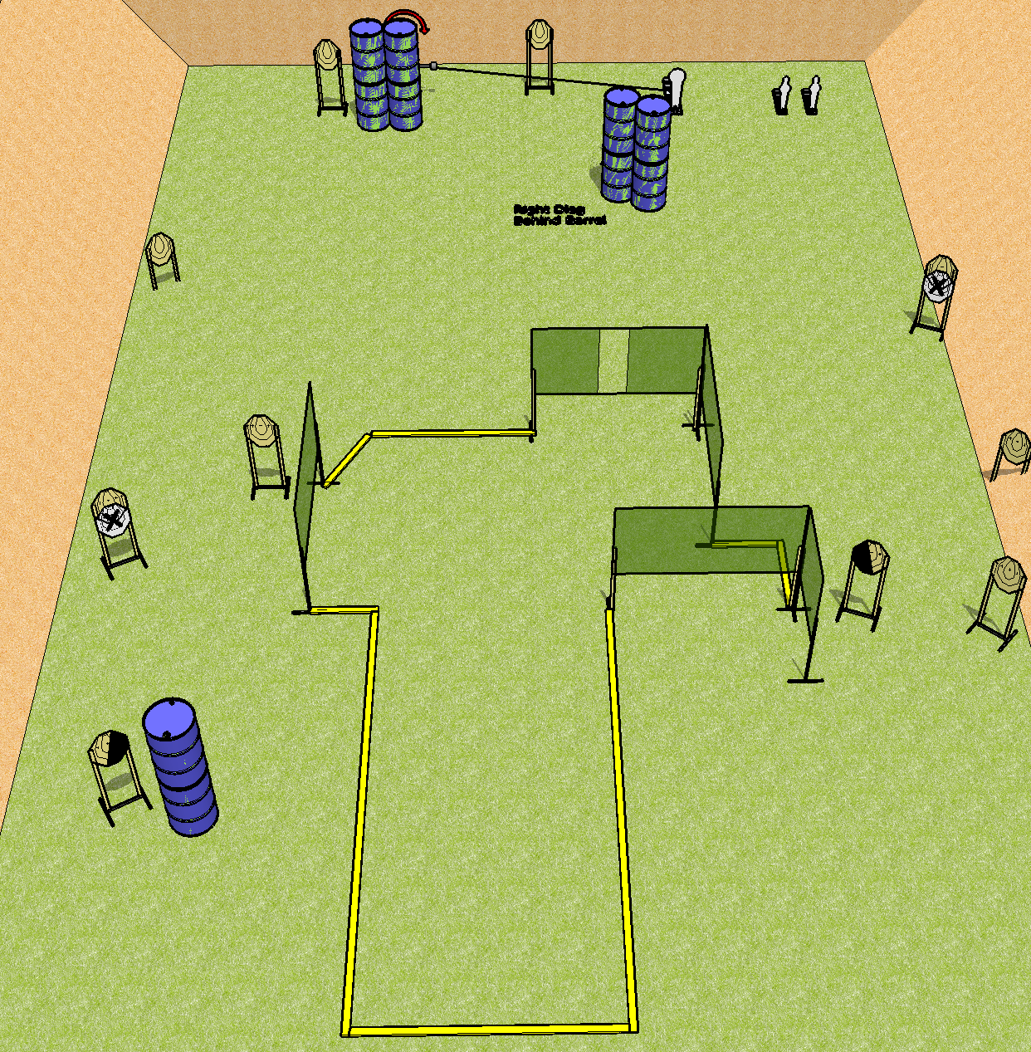
 | Dothan Gun Club – USPSA Match Go Down Range Course Designer : Drew Coleman Bay: A1
Round Count 27 rounds 12 IPSC 1 colt popper, 2 minis
Equipment List 8 wall feet Swinger + activator 2 right diag, 1 left diag 11 targets (9 + 2 NS)

Slide 12
Go Down Range
Written Stage Briefing
Scoring: Comstock Rounds: 27
Targets: 12 IPSC, 3 steel
Handgun start position: anywhere inside the shooting area, wrists below belt. Handgun is loaded and holstered.
PCC start position: anywhere inside the shooting area, stock on belt. Loaded carbine is held with both hands, safety on.
Stage Procedure: on the audible start signal, engage targets as they become available from within the shooting area. The swinger is activated by P1.

